Slide 1




USE ENGLISH AT A SUPERVISORY LEVEL
D2.LAN.CL10.02
Notes:
Trainer introduces the unit

Slide 2
Element 1: Use English to induct new employees
Performance criteria:
1.1
Welcome new employee(s) and introduce them to key personnel
Explain how the position relates to others in the company
1.2
1.3
Speak positively about the company structure, goals and priorities
1.4
Give information about the new employee’s roles and responsibilities
Show and explain features in the work area
1.5
1.6
Outline details of any training requirements
Notes:
Trainer introduces the element and goes through the performance criteria. Trainer informs trainees of assessment and work projects.

Slide 3

1.1 Welcome new employee(s) and introduce them to key personnel
An organization only has one chance to make a good first impression with the new hire, and the first few days will leave a lasting impression.
It is important then to make sure that all new employees are provided with an opportunity to meet the people they will work most closely with.
Notes:
Trainer introduces the slide and explains the importance of inducting staff effectively. The first impression of the organisation or team is important to establish a good rapport with the employee/s.

Slide 4

Planning for new employees
It is important that all staff receive the same level of support when they join your organisation. An organisation should:
Have a welcome strategy in place
Have a personal collage of all immediate staff
Have a mentor or buddy system
Express a genuine interest in the new employee as a person
Immerse the new staff member in the company culture
Notes:
Trainer explains the importance of having an induction strategy and making sure that the same process is applied to all new staff members.

Slide 5

Introducing people
It is important to practice:
Introducing yourself
Introducing others
Responding to introductions
Notes:
Trainer presents the slide and asks students to provide examples. Trainees read through the section in their TMs and practice with other students.

Slide 6
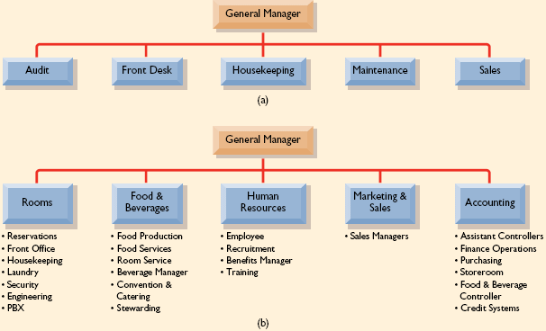
Key personnel
Notes:
Trainer shows the slide and explains the idea of an organisation chart. Trainees identify who they think are the most important or relevant people to their position or role. Trainees discuss and trainer supports.

Slide 7

1.2 Explain how the position relates to others in the company
It is important to understand how a position relates to other positions within an organisation in order to better achieve the overall goals of the company.
Notes:
Trainer introduces the performance criteria and explains the idea that positions interconnect and influence each others’ work. All staff rely on the accounting department to get their salary, and accounting requires supervisors to complete working hours of staff before they can pay the salary.

Slide 8

Role clarity and relationship to other positions
It is necessary to clearly outline the role of the new employee and how their position relates to other roles in the organisation. There may often be different levels within a company such as:
Managers
Supervisors
Operational staff
Notes:
Trainer presents slide and explains the different levels of authority within organisations. Trainer might want to show examples of organisational charts in the hospitality and tourism industry. There are many various examples available online. Trainees can read through the information in their TMs. Trainer asks trainees to identify how their position relates to others in the organisation.

Slide 9
1.3 Speak positively about the company structure, goals and priorities
Speaking positively about company goals, structure and priorities is an important role. It helps to:
Encourage and engage new employees
Show your awareness of the organisation and to share that knowledge
Align individual goals with company priorities and strategy
Identify who does what within the organisation
Notes:
Trainer presents information from the slide. Trainees read through the introduction in their TMs.

Slide 10
Organisation structure
There are many different types of organisation structures:
Functional
Departmental
Divisional
Notes:
Trainer explains each type of structure using information from TM. It is possible to incorporate other examples of organisational structure like mechanical and organic and to show companies that use these structures (Google, Airlines, Apple). There is a lot of information available on the internet to support examples.

Slide 11
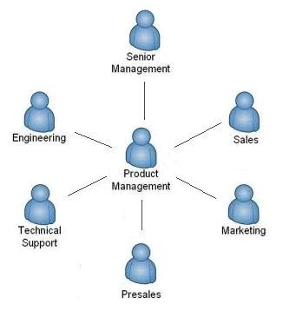
Organisational structure details
The significant components of organisational structure are:
Work specialisation
Span of control
Centralisation
Decentralisation
Formalisation
Departmentalisation
Chain of command
Notes:
Trainer presents the slide and trainees read through the explanation from their TMs. Trainees explain their own work context and structures using the terms in the slide. Is their workplace highly centralised, with very specific job roles or do staff perform multiple roles? Trainer can use examples of big hotel chains with strict guidelines, departments, SOPs etc versus smaller more organic hotels or organisations. Trainees complete the activity regarding organisational structure and report back to the class.

Slide 12
Speaking positively in the workplace
Some ideas to support speaking positively:
Smile when you speak. People will react differently when you put a little smile in your voice. It is human nature to mirror the person we are speaking to.
Focus on what you can do. Instead of “We can’t do that until next week,” try “We will be able to do that next week.”
Suggest alternatives and solutions. Instead of “That is okay, except…” say “If you do X , it will be perfect.”
Take responsibility – don’t lay blame others. Instead of “ It’s not my fault,” say “ Here’s what I can do to fix that.”
Avoid sounding pushy. Instead of “You‘ll have to,” say “Could you” or “Would you be able to” or “What I’ll need is…”
Use a yes we can attitude. Instead of “No, because…” say “Yes, as soon as…”
Notes:
Trainer presents the slide and trainees discuss how they can speak positively about their organisation. Trainees could present different aspects of their organistaional structure to the class using positive language. For example “Our company has many departments which makes it easy to find the right person to speak to about a specific issue or activity. Management is approachable and there are regular meetings where ideas or issues are welcomed.”

Slide 13

Vision and mission
Vision and mission statements:
Are important aspects which influence organisational culture
Create a foundation for values, priorities, company goals and objectives
Notes:
Trainer presents the idea of vision and mission statements. Trainees share their organisation’s vision and mission statements if known. Trainer explains how these statements influence company strategies and priorities and values through providing a foundation for how all activities in a company are supposed to be conducted. Trainer uses information from TM to explain the purpose of vision and mission statements.

Slide 14

1.4 Give information about the new employee’s roles and responsibilities
Identifying an employee’s roles and responsibilities is important to:
Show them clearly what is expected from their work
Set goals
Inform them of who they will work with
Allow them to ask for clarification
Notes:
Trainer presents slide and asks trainees if they have any other reasons why clear roles and responsibilities are effective. Trainees own responses.

Slide 15
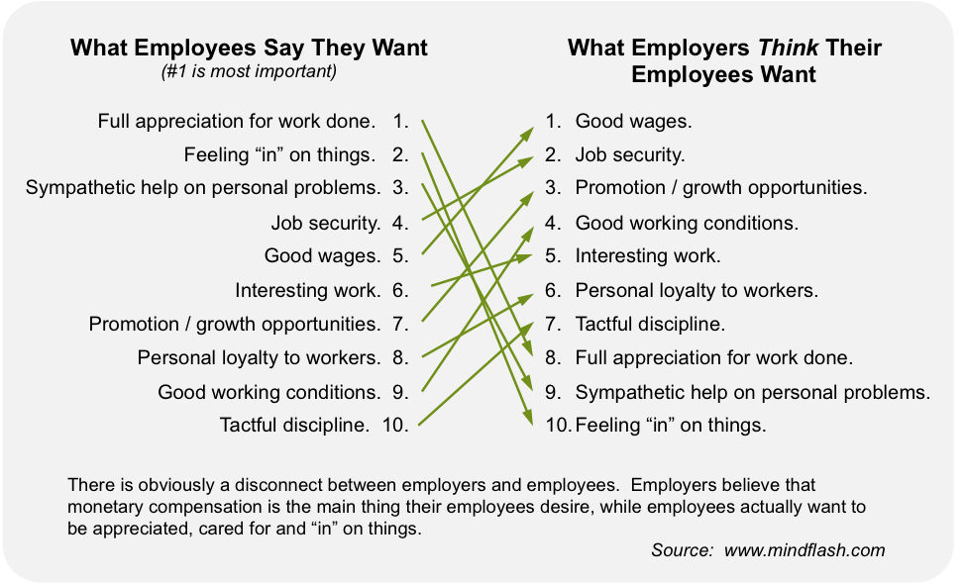
What employees value in their work role
Notes:
Trainer presents the slide and explains that often what employees value in the workplace are not always the same as what the organisation values. Clear job roles and responsibilities help to align company values and employee values. Trainer asks trainees to respond to the slide and ask if they agree or disagree. Students answer as appropriate and trainer guides discussion.

Slide 16

Job description
A job description identifies essential and non-essential tasks that are assigned to a specific position
It also identifies reporting relationships and may also describe required qualifications, minimum requirements, working conditions, and desirable qualifications
Notes:
Trainer shows the slide and goes through the purpose of a job description. Trainer asks trainees if their job descriptions clearly explain their roles and responsibilities. Trainer presents task and duty statement information from TMs and trainees read and ask questions as needed. Trainees read through the job description example and identify main duties and responsibilities. Trainer supports.

Slide 17

Language relating to job roles
Job descriptions and task statements often begin with:
Job tasks include:
Responsibilities include:
Main duties are:
Notes:
Trainer shows the slide and trainees read through the information in their TMs. Trainees read through the verbs list and ask for any explanation of words they don’t know. Trainer supports.

Slide 18

1.5 Show and explain features in the workplace
In explaining a particular work area for a staff member it may be useful to use phrases and expressions such as:
There is/There are
You will need....
This is where you will be working
This is a/an......
Have you used a ................. before?
Notes:
Trainer goes through the introduction to the performance criteria and students look at the slide. Trainer asks what other language may be useful to explain features in the workplace? Trainees respond as appropriate. Trainer facilitates discussion. Activity: students look at the equipment or items and decide which person may use the item. Trainer supports.
Activity: Write down all of the main items, materials and equipment that is needed in your position or choose a job and list the relevant items. Describe the main items to your partner. Trainees complete the activity and share with their groups. Who has the longest list?

Slide 19
1.6 Outline details of any training requirements
A job role may require certain training to be completed and it is important that any required training is explained clearly to a new employee.
Notes:
Trainer introduces the performance criteria and explains that training may be a requirement for certain roles.

Slide 20

Training requirements
In describing training requirements, it may be useful to use expressions like:
It is a requirement of the organisation that.......
You will be required to.........
You are expected to be able to............
You will have to attend training for........
Training will be provided for.........
This position requires that you are trained in these areas:....
Notes:
Trainees read through the information from their TMs and practice the language that may be useful for informing employees about training requirements. Trainer explains any unknown phrases and expressions.

Slide 21
Training requirements cont’d
It will be important to be able to explain the main information relating to the training such as:
When and how the training is delivered
How long it takes
What materials, items, clothing, or equipment is needed
Who arranges the training and how they contact the employee to inform them of the training
Where training takes place
What happens if the training outcome is unsuccessful
Is further training needed
How often training must be updated
Why the training is needed
Notes:
Trainer presents the slide and trainees read through the information from their TMs. Trainees discuss any on the job training they have experienced.

Slide 22

Training requirements cont’d
General training in organisations may include:
Evacuation and emergency procedures
First aid
How to use equipment specific to a position
HR manual/Operations manual use
Annual/Sick leave procedures
Customer service management
Quality assurance
IT
Meeting request/attendance procedures
Notes:
Trainer presents the slide and asks students if they have experienced any of this training. Trainees respond and share other training experiences as appropriate. Perhaps they have delivered training or received training. Trainees complete activity from their TMs.
Activity: Read through the training plan below (TM) and determine how you would describe this training to someone. Practice summarising the training with your partner.
Trainer reminds trainees of Work Projects and due dates. Trainer goes through summary of the Element and clarifies any questions from trainees.

Slide 23
Element 2: Conduct a staff meeting
Performance Criteria:
Notify all relevant staff of scheduled staff meeting
2.1
Draw up an agenda for the staff meeting
2.2
Chair the meeting
2.3
2.4
Develop an action plan and dates
Notes:
Trainer introduces the element and explains the assessment and work project requirements.
Trainer asks if trainees have attended meetings or conducted them before?

Slide 24

2.1 Notify all relevant staff of scheduled staff meeting
Each organisation will have different ways of organising and conducting meetings so it is important to be able to explain company specific meeting procedures clearly and effectively.
Notes:
Trainer introduces the slide and performance criteria. Trainees discuss the modes of communication within their organisation such as: emailing, notice boards, verbal, text messages etc.

Slide 25
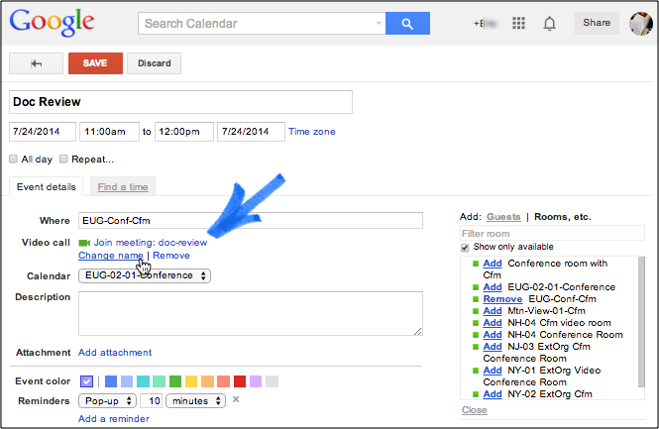
Communicating with staff
Notes:
Trainer explains the different ways of communicating within the workplace and students look at the example in the slide (TM). Have they seen this type of meeting request before? Have they used the system? What other methods do they use in their workplace?

Slide 26

Noticeboard
One common way to inform staff of a meeting is to use a staff noticeboard. The meeting information should include:
Meeting title
Date and time
Location
Reason for meeting
Materials to bring or information to prepare
Duration of meeting
Attendees (people who need to attend)
Notes:
Trainer asks trainees what should be included in a meeting request before showing the slide. Trainees respond and then trainer shows the slide. Trainer asks if a noticeboard is used in their organisation.

Slide 27

Online meeting requests
Below are some ideas for writing effective online meeting requests:
Succinct Subject Line (required)
Personal Introduction
Required Preparation
Meeting Date and Time (required)
Location (required)
Meeting Purpose (required)
Agenda
Invitee List
Notes:
Trainer asks students what information is needed for an effective online meeting request. Trainees read through the slide information. Have trainees used this method before? Trainees read through the explanation of each idea in their TMs and trainer supports as required

Slide 28
Meeting requests
Things to consider:
Send detailed meeting invitations for scheduled business meetings. Invitations aren't necessary for ad-hoc meetings
Failure to send a good invitation is inconsiderate and makes people unhappy!
The amount of information you need to write from scratch depends on the software you use to send your email
There are 4 required and 4 optional pieces of information to include
Notes:
Trainer goes through summary with trainees. Trainees explain the process in their workplace.

Slide 29

2.2 Draw up an agenda for a staff meeting
An agenda:
Communicates important information
provides an outline for the meeting
is a checklist to ensure that all topics are covered
lets participants know what will be discussed and gives them a chance to come prepared for the meeting
provides a focus for the meeting
Notes:
Trainer introduces the performance criteria and asks trainees to explain what an agenda is. Have trainees used an agenda before? Trainer explains why an agenda is important using the information in the slide and from the TM.
Trainees read through the create an effective agenda ideas in their TMs and trainer supports.
Trainees complete the agenda activity from their TMs. Trainer supports.

Slide 30

2.3 Chair the meeting
The chair controls the meeting:
All remarks are addressed through the chair
Members do not interrupt each other
Members aim to reach a consensus
A vote is taken if consensus is not reached
The majority wins the vote
All members accept the majority decision
Notes:
Trainer introduces the performance criteria and explains the idea of a chair/chairperson. Trainer asks trainees what the role of a chairperson is? Trainer uses TM and slide to answer.

Slide 31

Meeting chair duties
Summarising by the chairperson during meetings can:
Indicate progress, or lack of
Refocus discussion that has wandered off the point
Conclude one point and lead into the next
Highlight important points
Assist the secretary if necessary
Clarify any misunderstandings
Notes:
Trainer goes through the information with trainees and explains the role of the chair in relation to successfully running a meeting. Trainees could provide examples of good and bad meetings they have attended or conducted. What were the major factors that influenced the success or failure of the meetings? Trainees provide answers and trainer facilitates discussion.

Slide 32

Role of attendees
To ensure an effective meeting, all participants should:
Undertake any necessary preparation prior to the meeting
Arrive on time
Keep an open mind
Listen to the opinions of others
Participate
Avoid dominating the proceedings
Avoid conflict situations
Avoid side conversations which distract others
Ask questions to clarify understanding
Note down any action agreed upon
After the meeting, undertake any agreed action and brief others as appropriate
Notes:
Trainer highlights the need for attendees to participate in meetings actively to make them successful. Trainer goes through the slide with trainees and elicits any other ideas from students.
Trainees provide ideas on why a meeting may be unsuccessful. Trainees read through the information in their TMs regarding why meetings fail. Trainer encourages trainees to offer examples of when they have experienced similar situations.

Slide 33

2.4 Develop an action plan and dates
Often during a meeting certain actions will become apparent and it is important to develop a plan that details how these actions will get done.
Notes:
Trainer introduces the performance criteria and explains how meetings often result in actions or activities that are determined need to be completed.

Slide 34

Action plan development
When developing an action plan it is important to:
Express your solution as a series of goals
Generate a list of Actions for each goal
Prepare a timeline
Allocate resources
Develop strategies for monitoring progress
Assign tasks
Estimate costs/materials
Implement the plan
Notes:
Trainer explains that an action plan is an important way to monitor the progress of actions and to be able to identify issues or areas that require support. Trainer can access many examples of action plans online and share with trainees. Trainees can identify the important aspects of an action plan and check against the information in the slide and in their TMs.

Slide 35
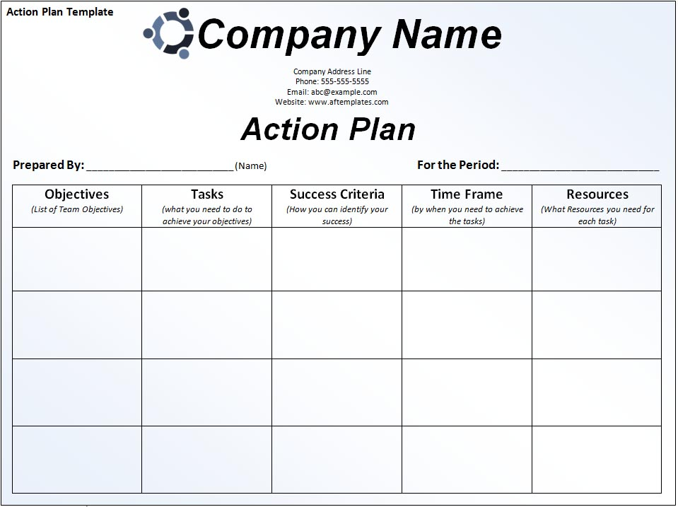
Action plan
Notes:
Trainees complete the activity in their TMs. They complete the action plan template with an objective from their workplace.
Trainer reminds trainees of work projects and assessment items. Trainer summarises the element and answers questions as required.

Slide 36
Element 3: Supervise and motivate a team
Performance criteria:
3.1
Give clear instructions of work to be completed and realistic deadlines
3.2
Check instructions have been understood by
3.3
Give constructive feedback on performance
3.4
Seek suggestions for improvements from staff
Notes:
Trainer introduces the element and explains the work projects and assessment due dates.

Slide 37

3.1 Give clear instructions of work to be completed and realistic deadlines
Giving clear instructions:
Don’t assume they know what you mean
Be clear and specific
Give timeframes
Give examples
Give alternatives
Set boundaries
Notes:
Trainer introduces the performance criteria and ask trainees to read through the slide. Trainees explain what they think each point means. Trainees read through the information in their TMs and trainer answers any questions as necessary. Trainees can write a set of clear instructions to do something simple that they know. Then share with their partner and see if their partner understands.

Slide 38

3.2 Check instructions have been understood by all involved
Before you let your staff loose on the basis of your instruction, it is useful to seek clarification from staff to ensure that they understand what the task at hand is and what is expected.
Notes:
Trainer introduces the slide and explains that checking for understanding is not as simple as saying “Do you understand?” Participants will often just answer yes when in fact they don’t understand as they don’t want to lose face in front of the group.

Slide 39

Concept checking
For example, some questions that could be asked to make sure staff have understood instructions are:
How long have you got to complete these tasks?
Who is responsible for task A, task B...?
What do you need to complete the tasks?
Who should you contact if you have a problem?
Should you ......?
Will you .....?
Gary, when is the next project update meeting? (Use names)
Notes:
Trainer explains the idea of concept checking using information from the TM. Trainees read through their TMs and ask questions as needed.
Trainer goes through the slide and explains how these questions check that participants understand the instructions.

Slide 40

3.3 Give constructive feedback on performance
Feedback is an essential element for everyone in an organisation's workforce:
Feedback is a useful tool for indicating when things are going in the right direction or for redirecting problem performance
Notes:
Trainer introduces the performance criteria and goes through the introduction from the TM. Trainer asks trainees why feedback is important? Trainer asks why people are often afraid of feedback? (Scared they have done something wrong, take it personally, feedback may be incorrect) Trainer asks if trainees like receiving/giving feedback? Trainer asks what they think are important aspects in giving constructive feedback?

Slide 41

How to give useful feedback
Some situations which require giving constructive feedback include:
Ongoing performance discussions
Providing specific performance pointers
Following up on coaching discussions
Giving corrective guidance
Letting someone know the consequences of their behaviour
Notes:
Trainer asks trainees when feedback is required in the workplace. Trainees offer own ideas then trainer shows the slide. Trainer asks what feedback participants have given in the past. Was the feedback successful? If not, what went wrong? Trainer encourages discussion.

Slide 42

Constructive feedback
Six ways to make feedback constructive:
If you can't think of a constructive purpose for giving feedback, don't give it at all
Focus on description rather than judgement
Focus on observation rather than inference
Focus on behaviour rather than the person
Provide a balance of positive and negative feedback
Be aware of feedback overload
Notes:
Trainer asks trainees how they give feedback. What techniques do they use to make feedback successful and effective?
Trainer presents the slide and uses information from the TM to explain each point. Trainees read through the six step constructive feedback suggestions in their TMs and discuss as a group. Trainer facilitates discussion and answers any questions.

Slide 43

3.4 Seek suggestions for improvement from staff
Why is it important to provide opportunities for staff to give feedback?
Engages staff
Makes them feel like they have a voice
They often have good ideas because they are closest to the work
Notes:
Trainer introduces the performance criteria and asks trainees why feedback from staff is important.
Do they seek feedback from staff? How? Why? Are staff comfortable to provide feedback? Trainees discuss in small groups.
Trainees read through the feedback section in their TMs and discuss in groups. Trainer asks if they have staff feedback surveys in their workplace. How often? Are they effective? Trainer encourages discussion about staff feedback.
Trainer reminds trainees of work projects and assessment. Trainer summarises the element and trainees ask questions as needed.

